Slide 1

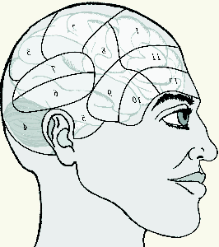
Building an mglair Agent a tutorial
Stuart C. Shapiro
Department of Computer Science and Engineering
And Center for Cognitive Science
University at Buffalo, The State University of New York

Slide 2
Thanks
To Jonathan P. Bona
For developing and implementing MGLAIR;
For help producing this tutorial.

Slide 3
Outline
Introduction: Partial review of keynote talk.
Example: The Delivery Agent.
In-depth study via an example agent.
With side-excursions to theory and use of SNePS & MGLAIR

Slide 4
Motivations
Add acting and sensing to a reasoning agent.
First person reasoning; on-line acting & sensing.
Layers
Motivated by mind/body connections/distinctions.
Let same mind be plugged into different bodies.
Embodiment
Origin of beliefs in sensation & proprioception.
First-person privileged knowledge of own body.
Situatedness
Has a sense of where it is in the world.
Symbol grounding
In body-layer structures.
Symbol as pivot between various modalities.

Slide 5
Motivations for Modalities
Independent but limited resources
Sensors and effectors are the resources
Different modalities can be used independently
Single modality has limited use

Slide 6
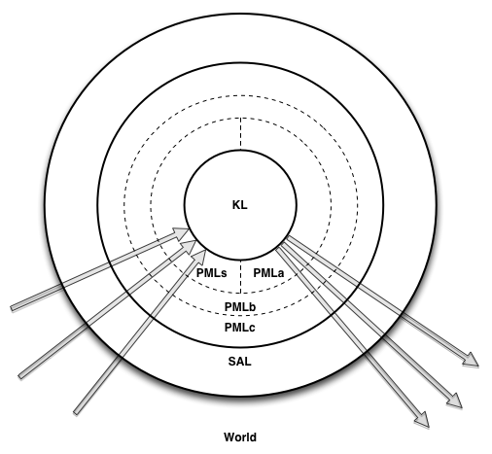

MGLAIR Architecture

Slide 7
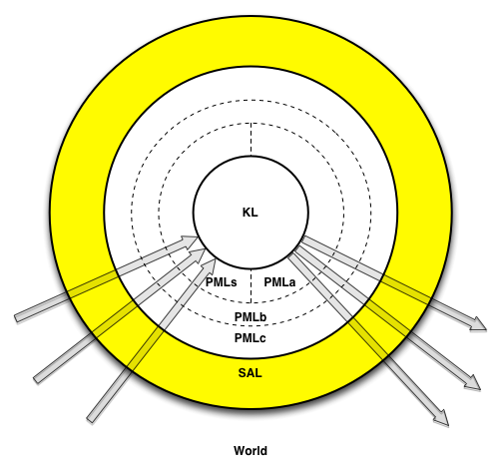
Sensori-Actuator Layer
Sensor and effector controllers

Slide 8
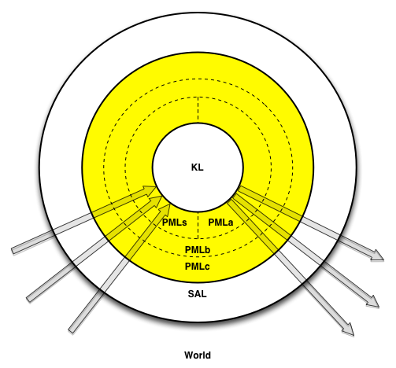
Perceptuo-Motor Layer
PMLa
PMLs
PMLb
PMLc

Slide 9
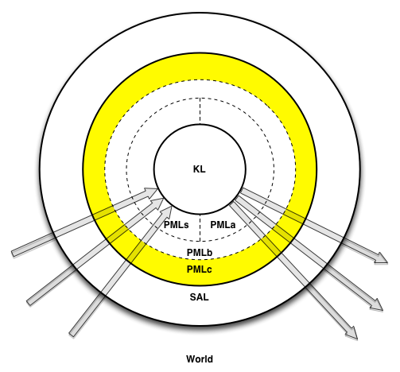
PMLc
Abstracts sensors & effectors
Body’s behavioral repertoire
Specific to body implementation

Slide 10
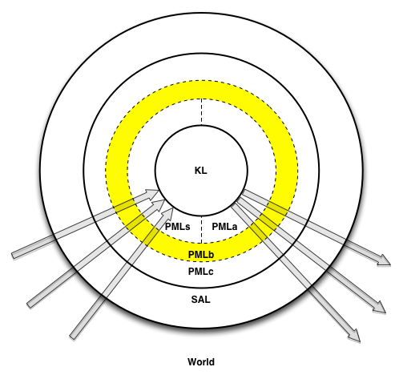
PMLb
Translation & Communication
Between PMLa/s & PMLc
Highest layer that knows body implementation

Slide 11
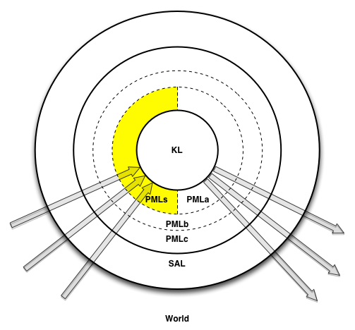
PMLs
Grounds KL symbols
Perceptual structures
Lowest layer that knows KL terms
Registers for Embodiment & Situatedness
Deictic Registers
Modality Registers

Slide 12
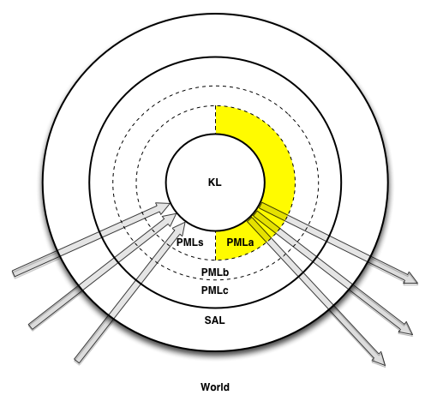
PMLa
Grounds KL symbols
Implementation of primitive actions
Lowest layer that knows KL terms
Registers for Embodiment & Situatedness
Deictic Registers
Modality Registers

Slide 13
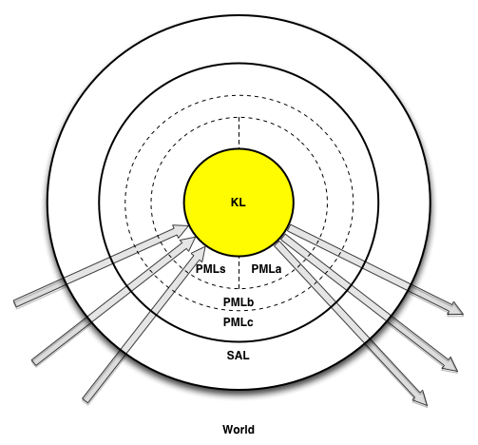
The Knowledge Layer
Implemented in SNePS
Agent’s Beliefs
Representations of conceived of entities
Semantic Memory
Episodic Memory
Quantified & conditional beliefs
Plans for non-primitive acts
Plans to achieve goals
Beliefs re. preconditions & effects of acts
Policies: Conditions for performing acts
Self-knowledge
Meta-knowledge

Slide 14
Afferent Modalities
Sensors
to Perceptual Structures
to Perception
to KL Terms

Slide 15
Efferent Modalities
KL Primitive Acts
to PMLa Methods
to act Impulses
to Effectors

Slide 16
Ontology of Mental Entities
Entity
Proposition
Agent can believe it or its negation
Includes quantified & conditional beliefs
Act
Agent can perform it
Policy
Condition-act rule agent can adopt
Thing
Action: What some agent can perform on some object(s)
Category: A category/class of entities
Other entities: individuals, properties, times, etc.

Slide 17

Entities, Terms, Symbols, Objects
Agent’s mental entity: a person named Stu
SNePS term: b4
Object in world:

Slide 18
Alignment
Afferent
Modality
Efferent
Modality
Mind (KL)
Thing
Action
Body (PML/SAL)
PMLs structure
PMLa method
World
Object/Phenomenon
Action

Slide 19
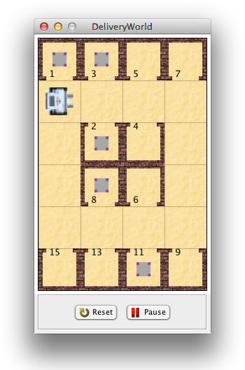
Example 1: The Delivery Agent
For Greenfoot, see Michael Kölling, The greenfoot programming environment, TOCE 10, ACM, 2010.

Slide 20
The Delivery Agent’s World
One floor of a building
4 corridors: North, South, East, West
12 Rooms, numbered:
1, 3, 5, 7, 9, 11, 13, 15,
2, 4, 6, 8
Packages in some rooms
3 visually distinguishable building parts:
room, corridor, wall

Slide 21
The Delivery Agent’s Task
Main Task: Deliver a package
from one room
to another room
Subtasks: Described below

Slide 22
Representation: Individual Constants
Directions: North, South, East, West
Room Numbers:
1, 3, 5, 7, 9, 11, 13, 15,
2, 4, 6, 8
Building Parts:
room, corridor, wall

Slide 23
Example Functions, Predicate
Functions:
c(d): The corridor on the d side
E.g.: c(North)
room(r) : The room numbered r
E.g.: room(1)
Predicate:
OnCorridor(r, c)
The proposition that room r faces corridor c.
E.g.: OnCorridor(room(1), c(North))

Slide 24
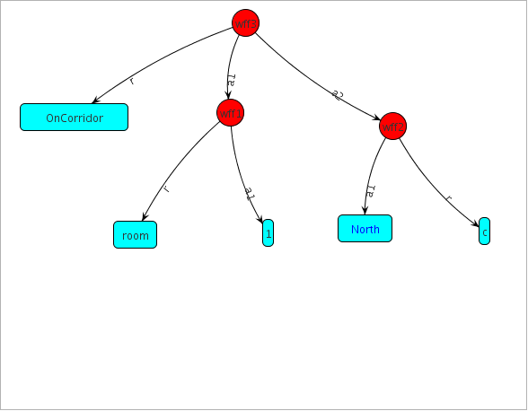
SNePS 2.8 Mode 1 (Default) Logical Forms, Frames, & Graphs
: OnCorridor(room(1), c(North)).
wff3!: OnCorridor(room(1),c(North))
: show wff3

Slide 25
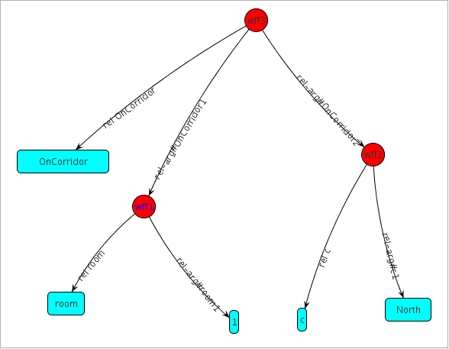
SNePS 2.8 Mode 2 Logical Forms, Frames, & Graphs
: set-mode-2
Net reset
: OnCorridor(room(1), c(North)).
wff3!: OnCorridor(room(1),c(North))
: show wff3

Slide 26
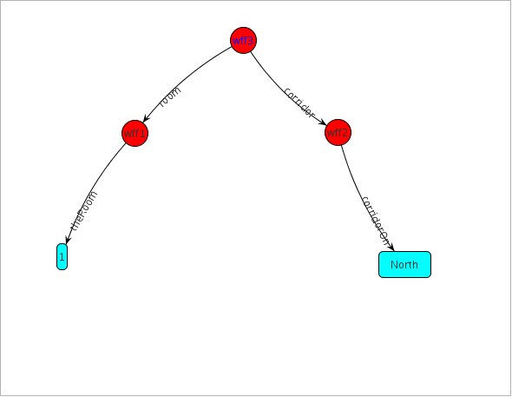
SNePS 2.8 Mode 3 (Required for Agents) Logical Forms, Frames, & Graphs
: set-mode-3
Net reset
: define-frame c(nil corridorOn)
c(x1) will be represented by
{<corridorOn, x1>}
: define-frame room(nil theRoom)
room(x1) will be represented by {<theRoom, x1>}
: define-frame OnCorridor (nil room corridor)
OnCorridor(x1, x2) will be represented by
{<room, x1>, <corridor, x2>}
: OnCorridor(room(1), c(North)).
wff3!: OnCorridor(room(1),c(North))
: show wff3

Slide 27
Corridors are Corridors, Main & Side
;;; Corridor(x): The proposition that x is a corridor.
define-frame Corridor(class member)
;;; MainCorridor(c):
;;; The proposition that c is one of
;;; the main corridors that rooms face onto.
define-frame MainCorridor(class member)
;;; SideCorridor(c):
;;; The proposition that c is a side corridor.
define-frame SideCorridor(class member)

Slide 28
Main and Side Corridors
: all(c)({MainCorridor(c), SideCorridor(c)}
v=> Corridor(c)). ; Note multiple fillers.
: MainCorridor({c(North), c(South)})! ; Note “!”
wff8!: Corridor(c(South))
wff7!: Corridor(c(North))
wff6!: MainCorridor(c(South))
wff5!: MainCorridor(c(North))
wff4!: MainCorridor({c(South),c(North)})
: SideCorridor({c(East), c(West)})!
wff15!: Corridor(c(West))
wff14!: Corridor(c(East))
wff13!: SideCorridor(c(West))
wff12!: SideCorridor(c(East))
wff11!: SideCorridor({c(West),c(East)})

Slide 29
Rooms are Rooms
;;; Room(x): The proposition that x is a room.
define-frame Room(class member)
: Room({room(1), room(2), room(3), room(4), room(5), room(6), room(7), room(8), room(9), room(11), room(13), room(15)}).

Slide 30
The Rooms on the Corridors
: OnCorridor({room(1), room(2),
room(3), room(4),
room(5), room(7)},
c(North)).
: OnCorridor({room(6), room(8),
room(9), room(11),
room(13),room(15)},
c(South)).
: OnCorridor({room(1), room(15)},
c(West)).
: OnCorridor({room(7), room(9)}, c(East)).

Slide 31
Agents with & without Models of Time
With a model of time:
Beliefs may have temporal arguments.
Beliefs of previous states remain associated with their times.
Allow for a moving NOW.
Support episodic memory.
Without a model of time:
All beliefs are about now.
No episodic memory.
Beliefs of previous states can be forgotten.
Requires Belief Revision (Truth Maintenance).
Delivery Agent has no model of time.

Slide 32
A Propositional Fluent
;;; AheadIs(x): The proposition that building part,
;;; x, is immediately in front of the agent.
define-frame AheadIs (nil ahead)
: xor{AheadIs(corridor),
AheadIs(room),
AheadIs(wall)}.
: AheadIs(corridor)!
wff6!: ~AheadIs(room)
wff5!: ~AheadIs(wall)
wff1!: AheadIs(corridor)

Slide 33
Some Non-Atomic Propositions
For any proposition, p:
~p
and{p1, …, pn}
p1 and … and pn
or{p1, …, pn}
p1 or … or pn
nand{p1, …, pn}
nor{p1, …, pn}
xor{p1, …, pn}
iff{p1, …, pn}
p1 <=> … <=> pn

Slide 34
Two Generalizations
For any propositions, p, integers, i<=j<=n:
andor(i,j){p1, …, pn}
thresh(i,j){p1, …, pn}

Slide 35
Some More Non-Atomic Propositions
For any propositions, p, q:
For any integers i, n, m:
{p1, …, pn} => {q1, …, qm}
{p1, …, pn} v=> {q1, …, qm}
{p1, …, pn} &=> {q1, …, qm}
{p1, …, pn} i=> {q1, …, qm}

Slide 36
Some More Non-Atomic Propositions
For any propositions, p, q:
For any integers i, j, k, n, m, i<=j<=k:
all(x1, …, xn}(p)
nexists(i,j,k)(x1,…,xn)(p1,…,pn : q1,…,qm}
nexists(_,j,_)(x1,…,xn)(p1,…,pn : q1,…,qm}
nexists(i,_,k)(x1,…,xn)(p1,…,pn : q1,…,qm}

Slide 37
Belief Revision: The 4-Story Building Example
: set-mode-1
: expert
: xor{OnFloor(1),OnFloor(2),OnFloor(3),OnFloor(4)}.
: {OnFloor(1),OnFloor(2)} v=> Location(belowGround).
: {OnFloor(3),OnFloor(4)} v=> Location(aboveGround).

Slide 38
Agent on Floor 1
: OnFloor(1)!
wff12!: ~OnFloor(|2|) {<der,{wff1,wff5}>}
wff11!: ~OnFloor(|3|) {<der,{wff1,wff5}>}
wff10!: ~OnFloor(|4|) {<der,{wff1,wff5}>}
wff6!: Location(belowGround) {<der,{wff1,wff7}>}
wff1!: OnFloor(|1|) {<hyp,{wff1}>}

Slide 39
Current Beliefs
: list-asserted-wffs
wff12!: ~OnFloor(|2|) {<der,{wff1,wff5}>}
wff11!: ~OnFloor(|3|) {<der,{wff1,wff5}>}
wff10!: ~OnFloor(|4|) {<der,{wff1,wff5}>}
wff9!: {OnFloor(|4|),OnFloor(|3|)} v=> {Location(aboveGround)}
{<hyp,{wff9}>}
wff7!: {OnFloor(|2|),OnFloor(|1|)} v=> {Location(belowGround)}
{<hyp,{wff7}>}
wff6!: Location(belowGround) {<der,{wff1,wff7}>}
wff5!: xor{OnFloor(|4|),OnFloor(|3|),OnFloor(|2|),OnFloor(|1|)}
{<hyp,{wff5}>}
wff1!: OnFloor(|1|) {<hyp,{wff1}>}

Slide 40
Move to Floor 4
: OnFloor(4)!
A contradiction was detected within context default-defaultct.
The contradiction involves the proposition you want to assert:
wff4!: OnFloor(|4|) {<hyp,{wff4}>}
and the previously existing proposition:
wff10!: ~OnFloor(|4|) {<der,{wff1,wff5}>}
You have the following options:
1. [a] to attempt to resolve the contradiction automatically
2. [c] to continue anyway, knowing that a contradiction is derivable;
3. [r] to revise the inconsistent part of the context manually
4. [d] to discard this contradictory new assertion from the context
(please type a, c, r or d)
=><= r

Slide 41
Revising the Context
In order to make the context consistent you must delete
at least one hypothesis from the set listed below.
An inconsistent set of hypotheses:
1 : wff5!: xor{OnFloor(|4|),OnFloor(|3|),OnFloor(|2|),OnFloor(|1|)} {<hyp,{wff5}>}
(4 supported propositions: (wff12 wff11 wff10 wff5) )
2 : wff4!: OnFloor(|4|) {<hyp,{wff4}>} ; Non-Prioritized Belief Revision
(1 supported proposition: (wff4) )
3 : wff1!: OnFloor(|1|) {<hyp,{wff1}>}
(4 supported propositions: (wff12 wff11 wff10 wff1) )
Enter the list number of a hypothesis to examine or
[d] to discard some hypothesis from this list,
[a] to see ALL the hypotheses in the full context,
[r] to see what you have already removed,
[q] to quit revising this set, or
[i] for instructions
(please type a number OR d, a, r, q or i)
=><= d
Enter the list number of a hypothesis to discard, [c] to cancel this discard, or [q] to quit revising this set.
=><= 3
…

Slide 42
Resultant Belief Set
: list-asserted-wffs
wff13!: ~OnFloor(|1|) {<ext,{wff4,wff5}>}
wff12!: ~OnFloor(|2|) {<der,{wff1,wff5}>,<der,{wff4,wff5}>}
wff11!: ~OnFloor(|3|) {<der,{wff1,wff5}>,<der,{wff4,wff5}>}
wff9!: {OnFloor(|4|),OnFloor(|3|)} v=> {Location(aboveGround)}
{<hyp,{wff9}>}
wff8!: Location(aboveGround) {<der,{wff4,wff9}>}
wff7!: {OnFloor(|2|),OnFloor(|1|)} v=> {Location(belowGround)}
{<hyp,{wff7}>}
wff5!: xor{OnFloor(|4|),OnFloor(|3|),OnFloor(|2|),OnFloor(|1|)}
{<hyp,{wff5}>}
wff4!: OnFloor(|4|) {<hyp,{wff4}>}

Slide 43
Summary of SNePS Belief Revision
Distinguishes hypotheses from derived beliefs.
Retains origin sets: the sets of hyps used to derive belief.
(ATMS)
Recognizes explicit contradictions.
Knows the possible culprits.
Allows the user to choose the actual culprit.
(Manual, “assisted”, BR.)
Current context (cc): set of hypotheses currently believed.
Current belief set: beliefs with an os that is a subset of cc.
But we don’t want manual BR to interrupt autonomous agent.
To be continued …

Slide 44
Acting
Prolog relies on a pun
d(X) :- a(X), b(X), c(X).
“,” means both logical “and” and sequence “and then”
Relies on left-to-right evaluation.
SNePS all(x)({a(x), b(x), c(x)} &=> d(x))
LHS can be evaluated concurrently
SNePS acting requires its own syntax & semantics

Slide 45
Types of Acts I
External Acts
affect the environment
supplied by agent designer
Mental Acts
affect the knowledge layer
believe, disbelieve
adopt, unadopt
Control Acts
sequence, selection, loop, etc.

Slide 46
Types of Acts II
Primitive Acts
Implemented as part of SNePS
or by agent designer in PMLa
Composite Acts
Structured by control acts
Defined Acts
Defined by ActPlan(α, p) belief

Slide 47
Propositions About Acts
Precondition(α, φ)
ActPlan(α₁, α₂)
GoalPlan(φ, α)
Effect(α, φ)

Slide 48
Policies Reasoning Acting
Forward Reasoning
whendo(φ, α)
wheneverdo(φ, α)
Backward Reasoning
ifdo(φ, α)

Slide 49
Acting Reasoning Control Acts 1
snif({if(φ₁, α₁), …, if(φ_{n}, α_{n}), [else(δ)]})
sniterate({if(φ₁, α₁), …, if(φ_{n}, α_{n}), [else(δ)]})
withsome(x, φ(x), α(x), [δ])
withall(x, φ(x), α(x), [δ])

Slide 50
Control Acts 2
achieve(φ)
do-all({α₁, …, α_{n}})
do-one({α₁, …, α_{n}})
snsequence(α₁, α₂)

Slide 51
The Acting Executive
perform(act):
pre := {p | ├ Precondition(act, p)};
notyet := pre - {p | p ε pre & ├ p};
if notyet not empty
then
perform(snsequence(
do-all({a | p ε notyet
& a = achieve(p)}),
act))
else {effects := {p | ├ Effect(act,p)};
if act is primitive
then apply(primitive-function(act),
objects(act))
else perform(do-one({p | ├ ActPlan(act,p)}));
believe(effects)

Slide 52
A Primitive Mental Act
believe(p)
Make p maximally epistemically entrenched.
Assert p as a hypothesis.
Do forward inference on p.

Slide 53
An Agent Approach to the 4-Story Building
: set-mode-3
: expert
;;; Use automatic Belief Revision
: br-mode auto
;;; Use an entrenchment ordering in which
;;; non-fluents are more entrenched than fluents.
: set-order fluent
;;; Automatically and arbitrarily break entrenchment ties.
: br-tie-mode auto
: define-frame OnFloor(nil onfloor)
: define-frame Location (nil location)
: ^(setf *fluents* '(OnFloor Location))
: ^(attach-primaction believe believe)

Slide 54
Initial Situation
: xor{OnFloor(1),OnFloor(2),OnFloor(3),OnFloor(4)}.
: {OnFloor(1),OnFloor(2)} v=> Location(belowGround).
: {OnFloor(3),OnFloor(4)} v=> Location(aboveGround).
: OnFloor(1)!
wff12!: ~OnFloor(|2|) {<der,{wff1,wff5}>}
wff11!: ~OnFloor(|3|) {<der,{wff1,wff5}>}
wff10!: ~OnFloor(|4|) {<der,{wff1,wff5}>}
wff6!: Location(belowGround) {<der,{wff1,wff7}>}
wff1!: OnFloor(|1|) {<hyp,{wff1}>}

Slide 55
Move to Floor 4
: perform believe(OnFloor(4))
: list-asserted-wffs
wff14!: ~OnFloor(|1|) {<ext,{wff4,wff5}>}
wff12!: ~OnFloor(|2|)
{<der,{wff1,wff5}>,<der,{wff4,wff5}>}
wff11!: ~OnFloor(|3|)
{<der,{wff1,wff5}>,<der,{wff4,wff5}>}
wff9!: {OnFloor(|4|),OnFloor(|3|)} v=>
{Location(aboveGround)} {<hyp,{wff9}>}
wff8!: Location(aboveGround) {<der,{wff4,wff9}>}
wff7!: {OnFloor(|2|),OnFloor(|1|)} v=>
{Location(belowGround)} {<hyp,{wff7}>}
wff5!: xor{OnFloor(|4|),OnFloor(|3|),
OnFloor(|2|),OnFloor(|1|)} {<hyp,{wff5}>}
wff4!: OnFloor(|4|) {<hyp,{wff4}>}

Slide 56
Back to the Delivery Agent

Slide 57
A Primitive External Efferent Act with Passive Afferent Feedback
KL: ;;; turn(d): The act of turning 90 degrees to the d, ;;; where d is "left" or "right". : define-frame turn(action dir) : ^(attach-primaction turn turn-act)

Slide 58
PMLa Definition of turn-act
(define-primaction turn-act ((dir))
(case (sneps:node-to-lisp-object dir)
(left (PMLb:turn 'locomotion 'PMLb:l))
(right (PMLb:turn 'locomotion 'PMLb:r))
(t (error “Trying to turn in ~
an unrecognized direction: ~S”
dir))))

Slide 59
Defining the locomotion Modality
(define-modality 'locomotion
:type 'efferent-modality
:predicates '(turn goForward)
:description
“Used by the agent to move and turn”
:channel '((port . 9576)
(host . localhost)))

Slide 60
PMLb Definition of turn
(defun turn (mod dir)
(execute mod (format nil "(tn . ~A)"
(if (eq dir 'l) -90 90))))

Slide 61
execute Puts an Impulse in a Modality Buffer
(defmethod execute ((mod efferent-modality)
impulse )
(if (= (capacity (buffer mod)) 0)
(dc-send mod impulse)
(if (vacancyp (buffer mod))
(add-to-buffer (buffer mod)
impulse))))

Slide 62
Turning at the PMLc and SAL Layers
Impulse removed from buffer by PMLc.handleImpulse
Calls bot.turnLeft()
Sets bot.direction to direction bot is facing.
Sets bot.rotation to angle bot is facing.
Next time bot.act() is called by Greenfoot,
ahead = "r", "w", or "c"
depending on object in next cell.
Calls PMLc.handleAhead(ahead)
Puts "(ahead . " + ahead + ")" in vision buffer.

Slide 63
Vision at the PMLb Layer
(set-sense-handler 'vision
#'vision-sense-handler)
(defun vision-sense-handler (v)
;; v is first message in vision buffer
(PMLs:perceive-vision
(read-from-string (rest v))))

Slide 64
PMLs Definition of perceive-ahead
(defun perceive-vision (p)
(case (first p)
(PMLb:ahead (perceive-ahead (rest p)))
(PMLb:room (perceive-room (rest p)))
(PMLb:on (perceive-package (rest p)))))
(defun perceive-ahead (p)
(believe "~A(~A)" 'AheadIs
(cond ((string= p "r") 'room)
((string= p "c") 'corridor)
((string= p "w") 'wall)
(t 'other)))

Slide 65
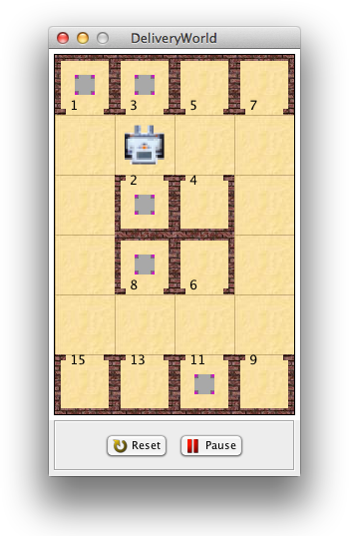
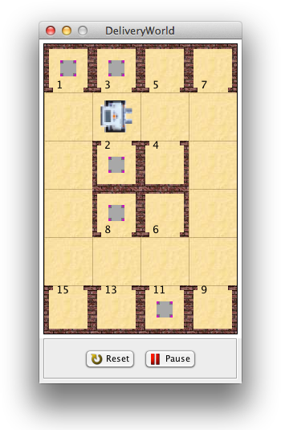
The Delivery Agent Turns Left
: AheadIs(?x)?
wff220!: ~AheadIs(room)
wff219!: ~AheadIs(wall)
wff105!: AheadIs(corridor)
: perform turn(left)
: AheadIs(?x)?
wff485!: ~AheadIs(corridor)
wff219!: ~AheadIs(wall)
wff106!: AheadIs(room)

Slide 66
Facing: A KL Sense of Orientation
: define-frame Facing (nil facing)
Facing(x1) will be represented by
{<facing, x1>}
: ^(push ‘Facing *fluents*)

Slide 67
Directions
: define-frame Direction (class member)
Direction(x1) will be represented by
{<class, Direction>, <member, x1>}
: Direction({North, South, East, West}).
: nexists(1,1,4)(d)(Direction(d): Facing(d)).

Slide 68
Use of Dead Reckoning
: define-frame Clockwise(nil ccwise cwise)
: Clockwise(North, East).
: Clockwise(East, South).
: Clockwise(South, West).
: Clockwise(West, North).
: all(d1)({Direction(d1), Facing(d1)} &=>
{all(d2)(Clockwise(d1,d2) =>
Effect(turn(right),Facing(d2))),
all(d2)(Clockwise(d2,d1) =>
Effect(turn(left),Facing(d2)))}).

Slide 69
Turning Left Again
: Facing(?x)?
wff214!: ~Facing(North)
wff213!: ~Facing(West)
wff211!: ~Facing(South)
wff205!: Facing(East)
: perform turn(left)
: Facing(?x)?
wff574!: ~Facing(East)
wff213!: ~Facing(West)
wff211!: ~Facing(South)
wff127!: Facing(North)

Slide 70
Facing Rooms
: define-frame Room(class member)
Room(x1) will be represented by
{<class, Room>, <member, x1>}
: Room({room(1), room(2), room(3),
room(4), room(5), room(6),
room(7), room(8), room(9),
room(11), room(13), room(15)}).
: nexists(_,1,_)(r)(Room(r): Facing(r)).

Slide 71
A Policy for Active Sensing
: define-frame readRoomNumber(action)
readRoomNumber() will be represented by
{<action, readRoomNumber>}
:^(attach-primaction
readRoomNumber read-act)
: wheneverdo(AheadIs(room),
readRoomNumber()).

Slide 72
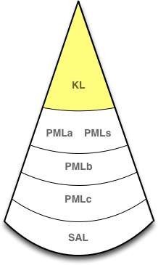

Reading a Room Number: KL
perform readRoomNumber()
Notes:
The agent performs readRoomNumber

Slide 73
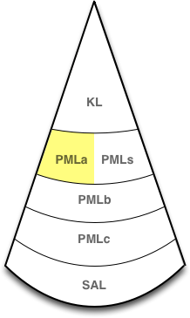
Reading a Room Number: PMLa
perform readRoomNumber()
(read-act)
Notes:
The PMLa function (read-act) is called because it is attached to the act node for read-room-number

Slide 74
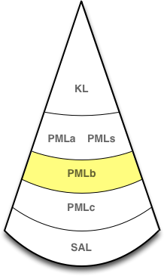
Reading a Room Number: PMLb
perform readRoomNumber()
(read-act)
(PMLb:read-room-number ‘visual-efferent)
Notes:
read-act calls PMLb:read-room-number, passing it the name of the modality to be used. PMLb:read-room-number doesn’t happen to have any other arguments, but others do: e.g. a PMLb function for turning using the agent’s locomotive modality might take a direction as its argument.

Slide 75
Reading a Room Number: PMLb
perform readRoomNumber()
(read-act)
(PMLb:read-room-number ‘visual-efferent)
(PMLb:execute ‘visual-efferent “(read . room)”)
Notes:
PMLb:read-room-number builds a representation of the act impulse that the PMLc will understand, and calls PMLb:execute, which will add that impulse to the modality’s data channel

Slide 76
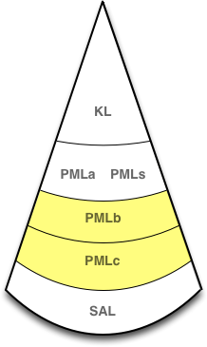
Reading a Room Number: PMLb - PMLc
perform readRoomNumber()
(read-act)
(PMLb:read-room-number ‘visual-efferent)
(PMLb:execute ‘visual-efferent “(read . room)”)
visual-efferent data channel:
“(61179134445 . (read . room))”
Notes:
The impulse(with a timestamp attached) enters the visual-efferent modality’s data channel

Slide 77
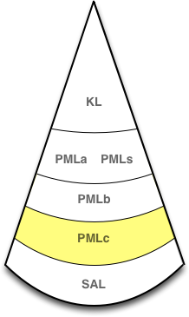
Reading a Room Number: PMLc
perform readRoomNumber()
(read-act)
(PMLb:read-room-number ‘visual-efferent)
(PMLb:execute ‘visual-efferent “(read . room)”)
visual-efferent data channel:
“(61179134445 . (read . room))”
PMLc.handleImpulse(“visual-efferent”,
“(61179134445 . (read . room))”
Notes:
Code in the PMLc monitors each modality’s data channel and, when an impulse arrives, calls PMLc.handleImpulse with the name of the modality and the impulse

Slide 78
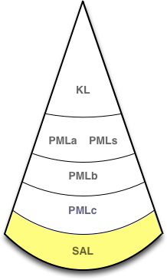
Reading a Room Number: SAL
perform readRoomNumber()
(read-act)
(PMLb:read-room-number ‘visual-efferent)
(PMLb:execute ‘visual-efferent “(read . room)”)
visual-efferent data channel:
“(61179134445 . (read . room))”
PMLc.handleImpulse(“visual-efferent”,
“(61179134445 . (read . room))”
bot.senseRoomNumber()
Notes:
PMLc.handleImpulse examines the impulse and calls the appropriate method in the SAL with any arguments if necessary. Here that looks like bot.senseRoomNumber()

Slide 79
Reading a Room Number: SAL
perform readRoomNumber()
(read-act)
(PMLb:read-room-number ‘visual-efferent)
(PMLb:execute ‘visual-efferent “(read . room)”)
visual-efferent data channel:
“(61179134445 . (read . room))”
PMLc.handleImpulse(“visual-efferent”,
“(61179134445 . (read . room))”
bot.senseRoomNumber()
bot.senseRoomNumber()
Notes:
senseRoomNumber() gets the number of the room the bot is facing (or 0)

Slide 80
Reading a Room Number: PMLc
perform readRoomNumber()
(read-act)
(PMLb:read-room-number ‘visual-efferent)
(PMLb:execute ‘visual-efferent “(read . room)”)
visual-efferent data channel:
“(61179134445 . (read . room))”
PMLc.handleRoomNumber(5)
PMLc.handleImpulse(“visual-efferent”,
“(61179134445 . (read . room))”
bot.senseRoomNumber()
bot.senseRoomNumber()
Notes:
senseRoomNumber() passes the room number to PMLc.handleRoomNumber

Slide 81
Reading a Room Number: PMLc
perform readRoomNumber()
(read-act)
(PMLb:read-room-number ‘visual-efferent)
(PMLb:execute ‘visual-efferent “(read . room)”)
visual-efferent data channel:
“(61179134445 . (read . room))”
PMLc.handleSense(“vision”, “(room . 5)”)
PMLc.handleRoomNumber(5)
PMLc.handleImpulse(“visual-efferent”,
“(61179134445 . (read . room))”
bot.senseRoomNumber()
bot.senseRoomNumber()
Notes:
PMLc.handleRoomNumber calls PMLc.handleSense, passing it the name of the modality and a representation of the sense that the PMLb will understand

Slide 82
Reading a Room Number: PMLc - PMLb
perform readRoomNumber()
(read-act)
(PMLb:read-room-number ‘visual-efferent)
(PMLb:execute ‘visual-efferent “(read . room)”)
vision data channel: “(room . 5)”
visual-efferent data channel:
“(61179134445 . (read . room))”
PMLc.handleSense(“vision”, “(room . 5)”)
PMLc.handleRoomNumber(5)
PMLc.handleImpulse(“visual-efferent”,
“(61179134445 . (read . room))”
bot.senseRoomNumber()
bot.senseRoomNumber()
Notes:
The PMLc adds the impulse “(room . 5)” to the visual modality’s data channel

Slide 83
Reading a Room Number: PMLb
perform readRoomNumber()
(read-act)
(PMLb:read-room-number ‘visual-efferent)
PMLb:vision-sense-handler(“(room . 5”))
(PMLb:execute ‘visual-efferent “(read . room)”)
vision data channel: “(room . 5)”
visual-efferent data channel:
“(61179134445 . (read . room))”
PMLc.handleSense(“vision”, “(room . 5)”)
PMLc.handleRoomNumber(5)
PMLc.handleImpulse(“visual-efferent”,
“(61179134445 . (read . room))”
bot.senseRoomNumber()
bot.senseRoomNumber()
Notes:
A sense-handler attached to the visual modality receives every impulse that passes through that modality. It’s job is to process each sense message and pass it to the PMLs function that performs perception.

Slide 84
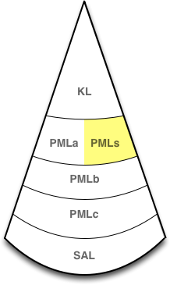
Reading a Room Number: PMLs
perform readRoomNumber()
(read-act)
PMLs:perceive-vision((room . 5))
(PMLb:read-room-number ‘visual-efferent)
PMLb:vision-sense-handler(“(room . 5”))
(PMLb:execute ‘visual-efferent “(read . room)”)
vision data channel: “(room . 5)”
visual-efferent data channel:
“(61179134445 . (read . room))”
PMLc.handleSense(“vision”, “(room . 5)”)
PMLc.handleRoomNumber(5)
PMLc.handleImpulse(“visual-efferent”,
“(61179134445 . (read . room))”
bot.senseRoomNumber()
bot.senseRoomNumber()
Notes:
The visual modality’s perceptual function at the PMLs, perceive-vision processes all vision for the agent. Here, it will examine the structure (room . 5) and produce a percept corresponding to the agent’s facing room 5

Slide 85
Reading a Room Number: KL
perform readRoomNumber()
perform believe(Facing(room(5)))
(read-act)
PMLs:perceive-vision((room . 5))
(PMLb:read-room-number ‘visual-efferent)
PMLb:vision-sense-handler(“(room . 5”))
(PMLb:execute ‘visual-efferent “(read . room)”)
vision data channel: “(room . 5)”
visual-efferent data channel:
“(61179134445 . (read . room))”
PMLc.handleSense(“vision”, “(room . 5)”)
PMLc.handleRoomNumber(5)
PMLc.handleImpulse(“visual-efferent”,
“(61179134445 . (read . room))”
bot.senseRoomNumber()
bot.senseRoomNumber()
Notes:
PMLs:perceive vision builds the term Facing(room(5)) and asserts it to the KL

Slide 86
Reading a Room Number: KL
Facing(room(5))
perform readRoomNumber()
perform believe(Facing(room(5)))
(read-act)
PMLs:perceive-vision((room . 5))
(PMLb:read-room-number ‘visual-efferent)
PMLb:vision-sense-handler(“(room . 5”))
(PMLb:execute ‘visual-efferent “(read . room)”)
vision data channel: “(room 5)”
visual-efferent data channel:
“(61179134445 . (read . room))”
PMLc.handleSense(“vision”, “(room . 5)”)
PMLc.handleRoomNumber(5)
PMLc.handleImpulse(“visual-efferent”,
“(61179134445 . (read . room))”
bot.senseRoomNumber()
bot.senseRoomNumber()
Notes:
The agent now consciously believes that it is facing room 5

Slide 87
Turning Left Yet Again
: Facing(?x)?
wff214!: ~Facing(North)
wff213!: ~Facing(West)
wff211!: ~Facing(South)
wff205!: Facing(East)
: perform turn(left)

Slide 88
After Turning Left
: Facing(?x)?
wff575!: ~Facing(room(6))
wff574!: ~Facing(room(15))
wff573!: ~Facing(room(5))
wff572!: ~Facing(room(4))
wff571!: ~Facing(room(13))
wff570!: ~Facing(room(7))
wff569!: ~Facing(room(2))
wff568!: ~Facing(room(9))
wff567!: ~Facing(East)
wff289!: Facing(room(3))
wff213!: ~Facing(West)
wff211!: ~Facing(South)
wff127!: Facing(North)

Slide 89
Some Subgoals (used with achieve and GoalPlan)
Facing(direction)
In(corridor)

Slide 90
Defined Acts
turnAround()
go(d) ; go one step in direction d
goTo(corridor)
goToEnd() ; of corridor in direction facing
face(room) ; in the direction toward room
goTo(room) ; into the room
leaveRoom()

Slide 91
Example Contingent Plans
all(r)(Facing(room(r))
v=> {ActPlan(goTo(room(r)), goForward()),
all(r2)(Opposite({room(r), room(r2)})
=>
ActPlan(goTo(room(r2)),
snsequence(turnAround(),
goForward())))}).
Note the importance of belief revision

Slide 92
A Plan to Deliver Packages
all(r1,r2)({Room(r1), Room(r2)}
&=> {ActPlan(deliverPackage(r1,r2),
snsequence5(goTo(r1),
pickUp(),
goTo(r2),
putDown(),
leaveRoom()))}).

Slide 93
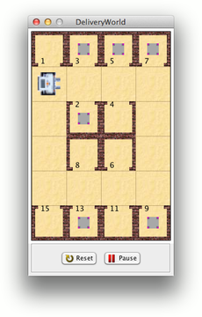
performing deliverPackage(room(9),room(8))

Slide 94
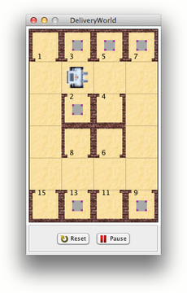
performing deliverPackage(room(9),room(8))

Slide 95
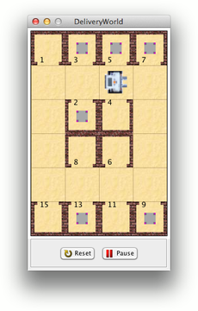
performing deliverPackage(room(9),room(8))

Slide 96
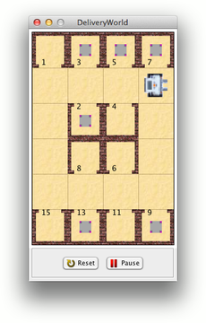
performing deliverPackage(room(9),room(8))

Slide 97
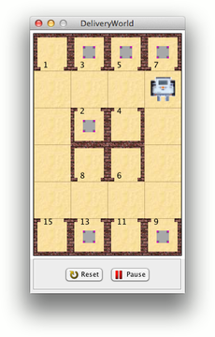
performing deliverPackage(room(9),room(8))

Slide 98
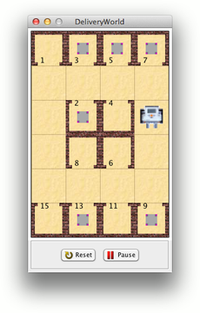
performing deliverPackage(room(9),room(8))

Slide 99
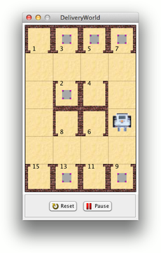
performing deliverPackage(room(9),room(8))

Slide 100
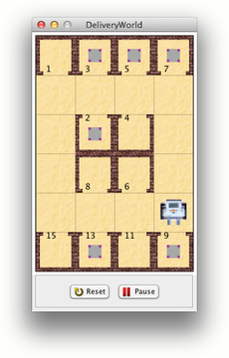
performing deliverPackage(room(9),room(8))

Slide 101
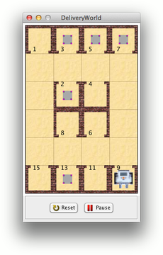
performing deliverPackage(room(9),room(8))

Slide 102
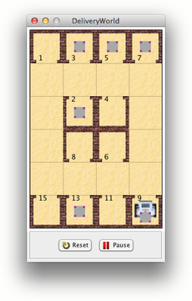
performing deliverPackage(room(9),room(8))

Slide 103

performing deliverPackage(room(9),room(8))

Slide 104

performing deliverPackage(room(9),room(8))

Slide 105
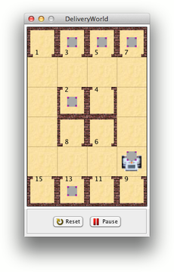
performing deliverPackage(room(9),room(8))

Slide 106

performing deliverPackage(room(9),room(8))

Slide 107

performing deliverPackage(room(9),room(8))

Slide 108

performing deliverPackage(room(9),room(8))

Slide 109
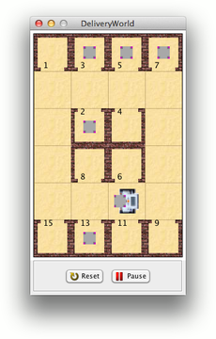
performing deliverPackage(room(9),room(8))

Slide 110
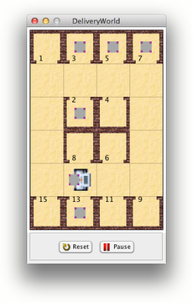
performing deliverPackage(room(9),room(8))

Slide 111
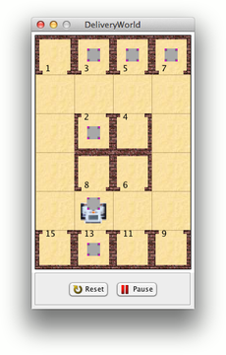
performing deliverPackage(room(9),room(8))

Slide 112
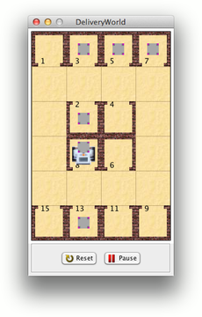
performing deliverPackage(room(9),room(8))

Slide 113
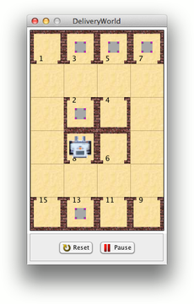
performing deliverPackage(room(9),room(8))

Slide 114
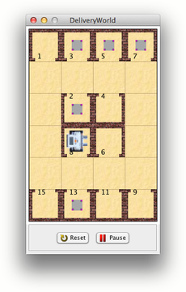
performing deliverPackage(room(9),room(8))

Slide 115
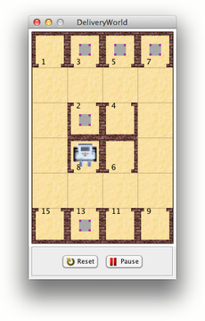
performing deliverPackage(room(9),room(8))

Slide 116
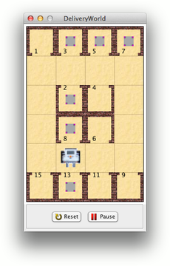
performing deliverPackage(room(9),room(8))

Slide 117
Summary
MGLAIR Architecture for
First-Person Reasoning, On-Line Acting, Agents
Layers: KL, PMLa/s, PMLb, PMLc, SAL
SNePS KR at the KL
Representation of Acts
Mental, Control, External
Primitive, Composite, Defined
Modalities
Individually Limited, Mutually Independent
Efferent and Afferent
Go through the layers
Primitive Acts Grounded in Efferent Modalities
Perceivable Entities Grounded in Afferent Modalities
Belief Revision
For keeping current in a changing world
For contingent plans

Slide 118
For More Information/Papers/Downloads
http://www.cse.buffalo.edu/~shapiro/
http://www.cse.buffalo.edu/sneps/

